Slide 1
Comparison of platform streaming platform movie offerings
Nyat Araya
Justin Baytosh
Mahederemariam Bayleyegn Dagne
Frank King

Slide 2

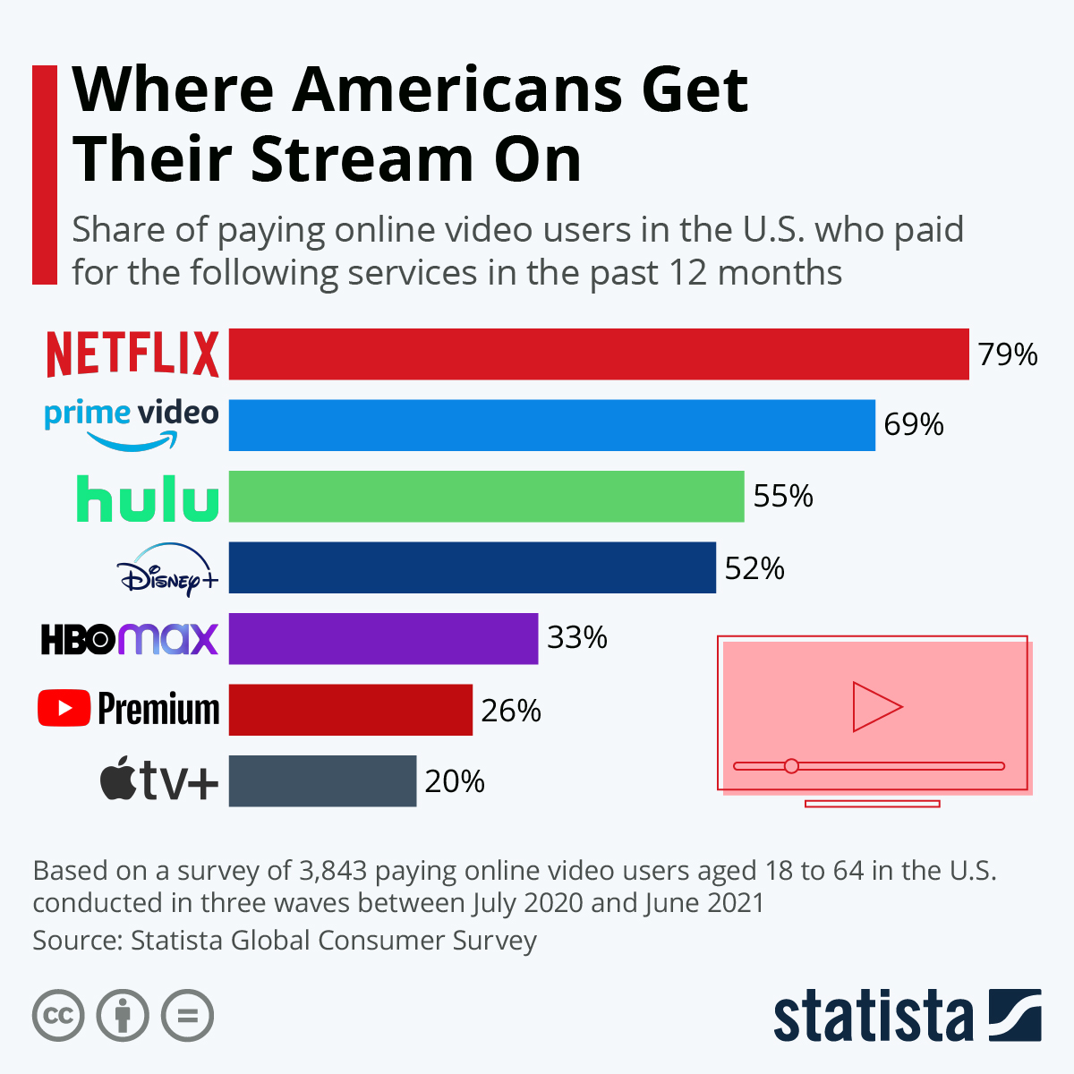
Background
The global video streaming market was valued at USD 50.11B in 2020
Netflix currently holds the largest market share at 20%, followed by Prime Video at 16%
This market is expected to expand at a compound annual growth rate (CAGR) of 21.0% from 2021 to 2028
The popular streaming platforms have different movie offerings
Due to different licensing agreements with movie studios
How does a customer determine which platform has offerings most desirable to them?
Customer demographics: age, location, gender, etc.
Interests: new releases, genres, critically-acclaimed

Slide 3
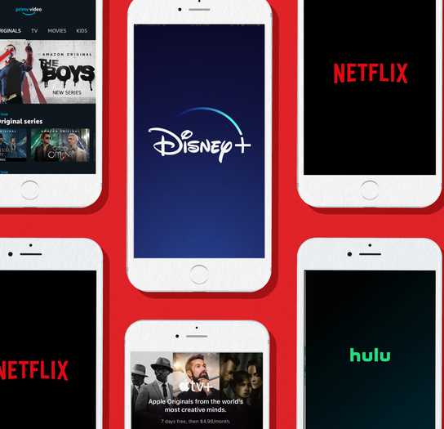
Purpose
The purpose of our project is to compare the movie offerings of popular streaming platforms
Release Date
Movie Rating
Number of Movies
This is relevant to customers and investors alike
Customers want to find the platform with the best movie offerings
Investors want their company to have better movie offerings than their competitors

Slide 4
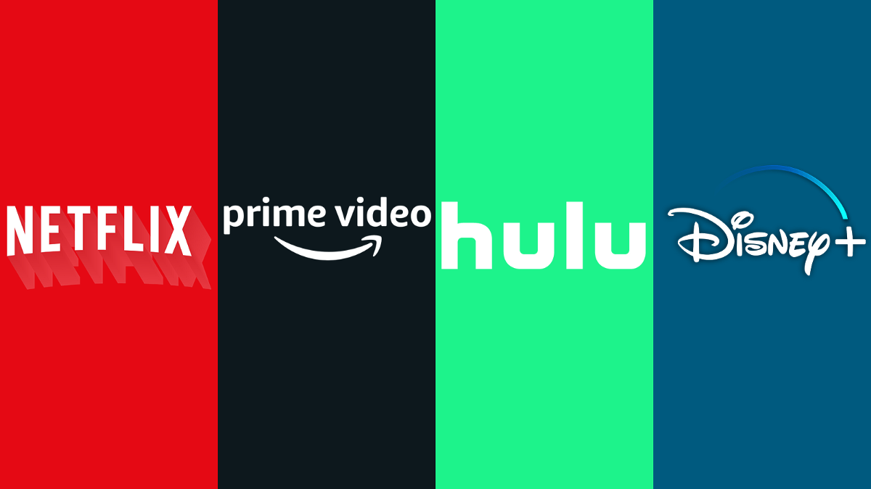
Analysis
Which streaming platform offers recent movies?
Which streaming platform offers the highest number of movies?
Which streaming platform provides movies with better Rotten Tomatoes scores?

Slide 5

solution
By performing these additional analyses, streaming platform customers will be able to decide which platform has the most recent, greatest quantity, and highest quality of movie offerings.
Additionally, investors will be able to compare their company's movie offerings to their competitors.

Slide 6
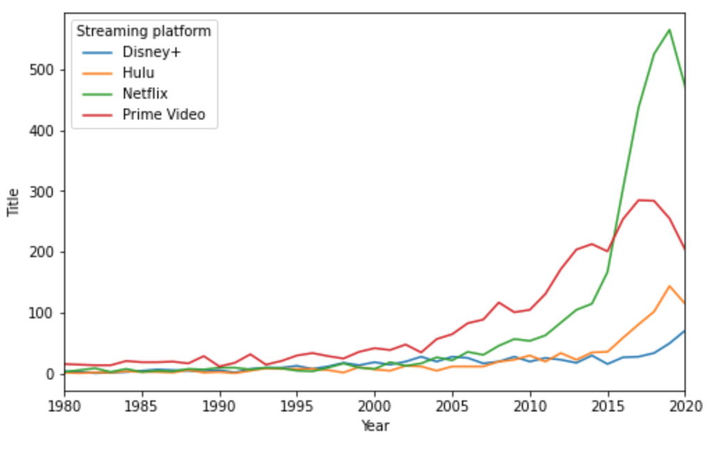
Analysis: Movie release year
We found that the Streaming platform that offers the most recent movies is Netflix followed by Prime video, Hulu and Disney+
Highest number of movies between 2015-2020 period
Most recent movies --> Netflix

Slide 7
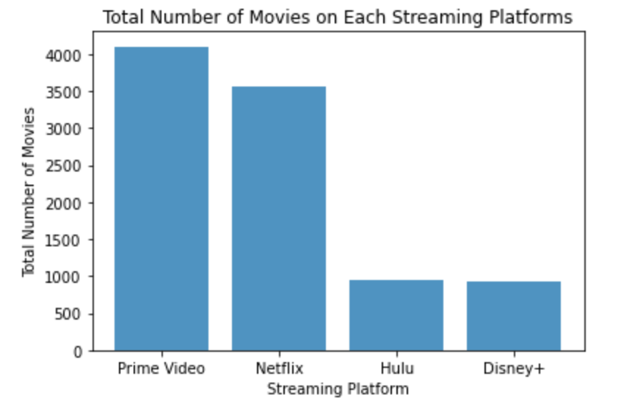
Analysis: Movie quantity
Based on total number of movies, Amazon Prime Video has the largest movie offerings out of the four popular streaming platforms at 4100
Netflix comes in second at 3550, followed by Hulu (943), and Disney+ (922)
With this finding in mind, a customer solely interested in total number of movies would be most attracted to Amazon Prime Video.

Slide 8

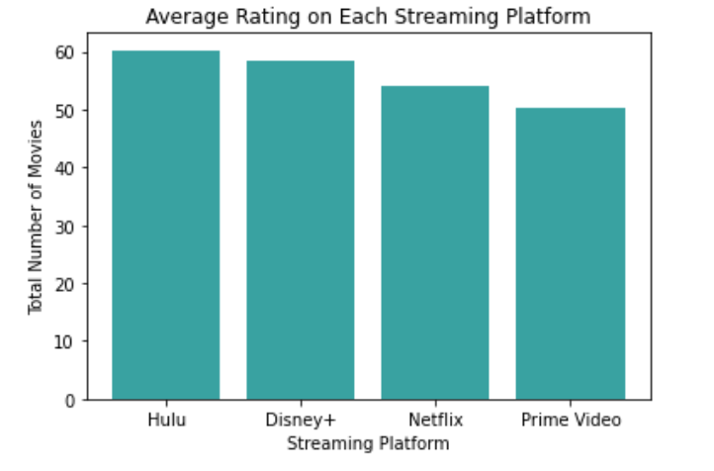
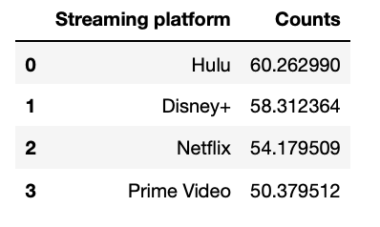
Analysis: Movie Rating
Based on the chart, we can see that Hulu has the highest average rating compared to the 4 popular streaming platforms

Slide 9
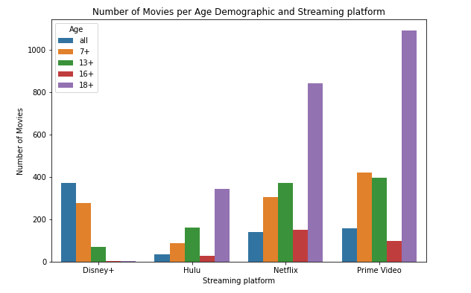
Advanced Analysis: Movie quantity & age
This identifies which streaming platform best fits movie interests by age
The streaming platform that offers the most movies for 18+ is Prime Video, Netflix and Hulu respectively. Disney+ offers the highest number of movies for all age demographics

Slide 10
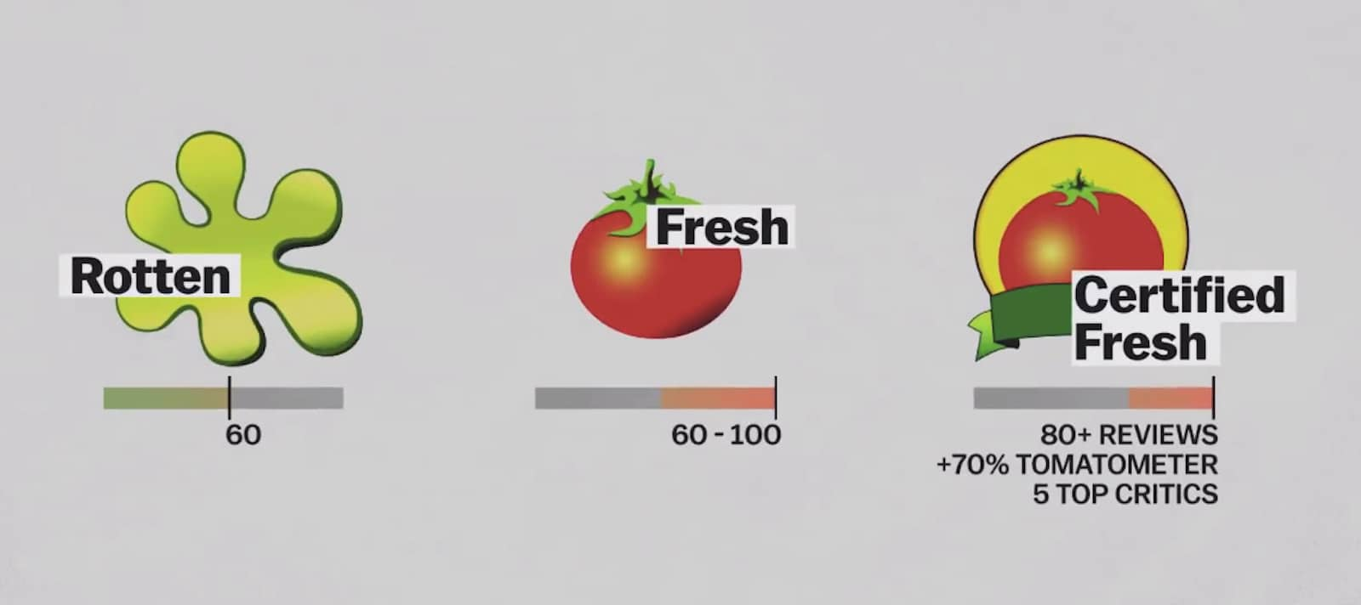
Advanced Analysis: MOVIE RATING & MOVIE QUANTITY
While Amazon Prime Video offers the greatest quantity of movies (4100), this finding does not take into account the rating of movies.
According to Rotten Tomatoes, a Tomatometer® score of 60% or greater indicates a fresh status
Only 876/4100, or 21.4% of Prime Video movies meet this criteria

Slide 11
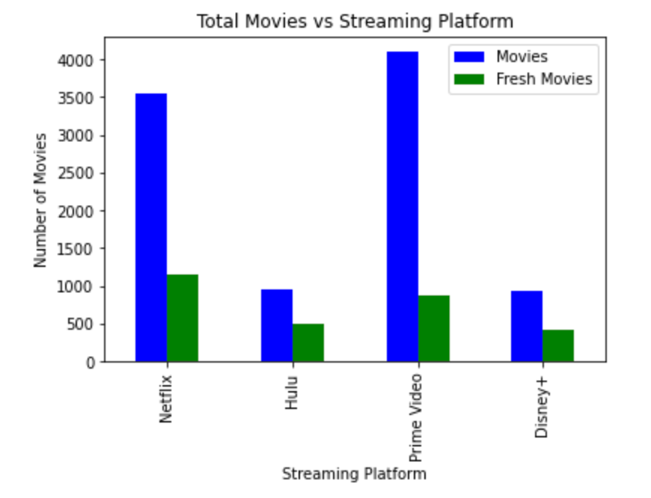
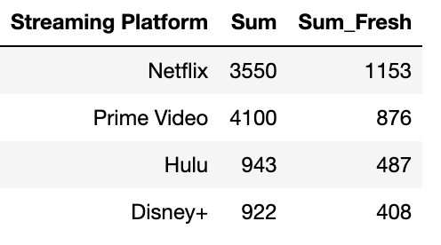
Advanced Analysis: MOVIE Rating & MOVIE QUANTITY
After filtering out movies that did not receive a Fresh status via Rotten Tomatoes' Tomatometer®, each streaming platforms quantity of movie offerings were recalculated
Prior to this recalculation, Amazon Prime Video had the largest quantity of movie offerings
Taking into account movie rating, Netflix offers the greatest quantity of movies with Fresh status

Slide 12
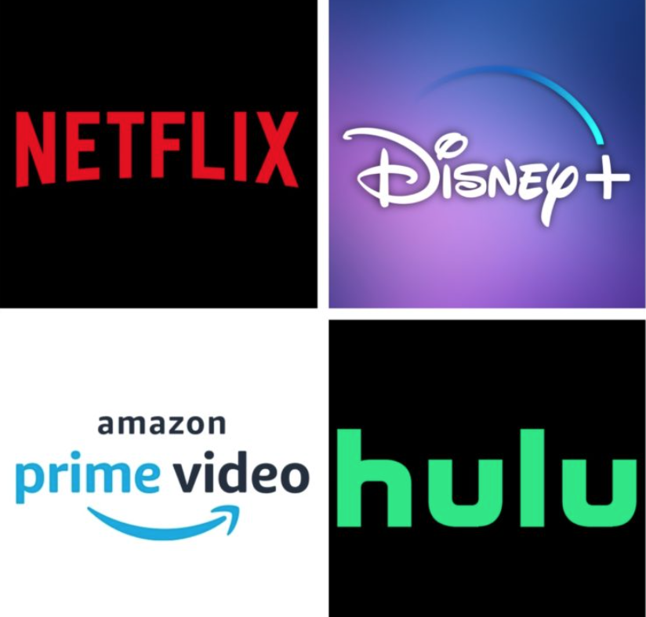
Conclusion
Through our analysis, we identified that Netflix is the streaming platform with the most recent movies
Amazon Prime offers the largest selection of movies compared to the other streaming platforms
Netflix has the highest number of movies rated "Fresh" on Rotten Tomatoes

Slide 13




Team members
Nyat ARAYA
JUSTIN BAYTOSH
MAHEDEREMARIAM BAYLEYEGN DAGNE
FRANK KING

